Slide 1

Executive Sales Analysis Dataset
Data Cleaning & Business Insights
Presented by Chandan Shridhar Hegde

Slide 2
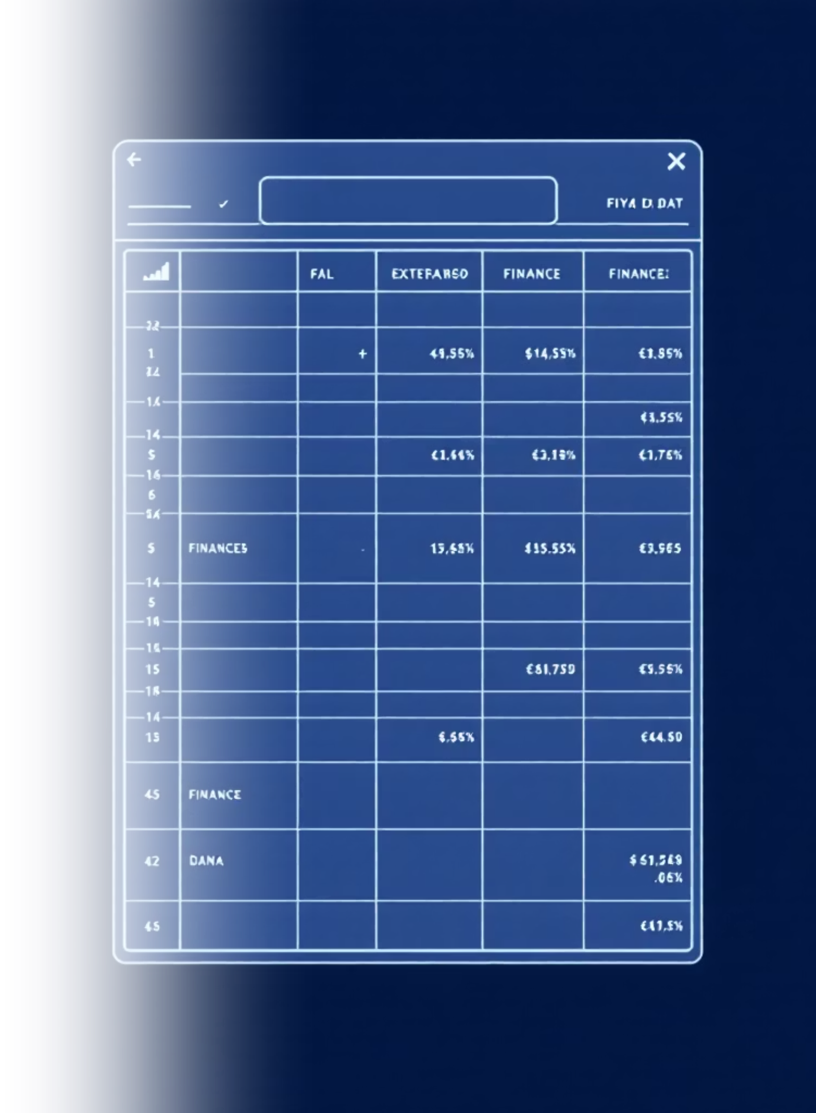
CHAPTER 1
Dataset Understanding
Our analysis begins with a comprehensive sales transaction dataset. This dataset provides the foundational data for evaluating financial performance across various dimensions.
Date: Transaction date
Country: Sales region (e.g., USA, Canada, France)
Product: Item sold (e.g., Paseo, VTT, Amarilla)
Sales: Revenue generated from sale
Gross Sales: Total sales before discounts
Profit: Net profit from the transaction
COGS (Cost of Goods Sold): Direct costs attributable to product
Discount Band: Level of discount applied
Manufacturing Price: Cost of producing the product
The primary purpose of analyzing this dataset is to gain actionable insights into financial performance by dissecting sales data across different countries, product lines, and over time.

Slide 3
CHAPTER 2
Data Preprocessing with Python
Ensuring data quality is paramount for accurate insights. Before any dashboard construction, the raw dataset underwent a rigorous cleaning process utilizing Python's powerful data manipulation libraries. This foundational step guarantees the reliability of all subsequent analyses.
01
02
03
Load Dataset
Clean Column Names
Handle Missing Values
Excel dataset imported using the pandas library for efficient data handling.
Removed extraneous spaces from column headers for consistent referencing.
Identified and addressed missing data points, filling 'Discount Band' with "No Discount" where applicable.
04
05
06
Remove Duplicates
Format Date Column
Create New Column
Ensured data uniqueness by eliminating any redundant transaction records.
Converted the 'Date' column to a proper datetime format for time-series analysis.
Generated 'Profit Margin %' to enrich the dataset with a crucial performance metric.
07
Export Cleaned Data
Output the preprocessed dataset to a new Excel file, ready for dashboard integration.

Slide 4
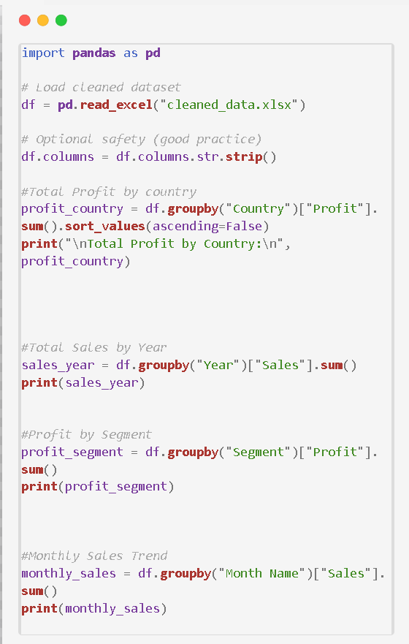
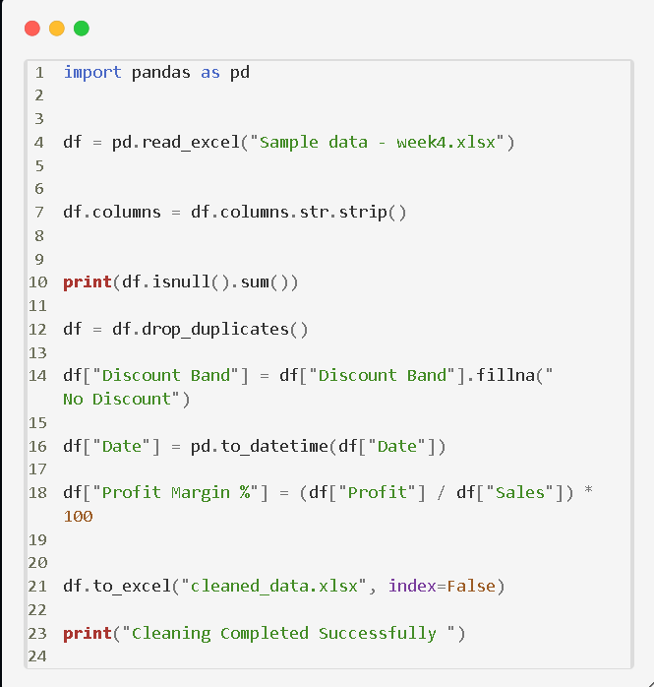
Data Preprocessing with Python
Data Analysis with Python

Slide 5
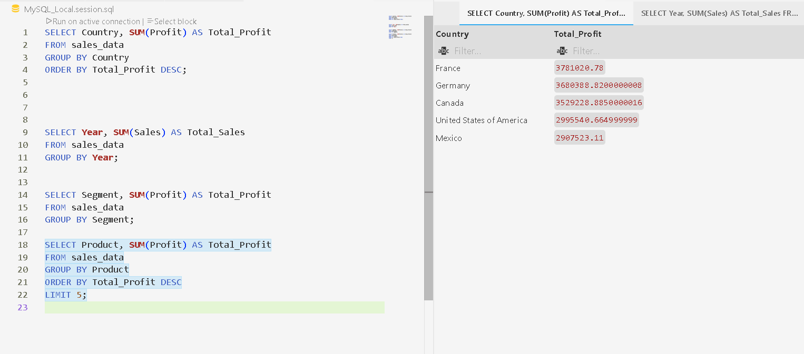
Data Analysis with SQL

Slide 6
Derived Feature: Profit Margin %
To gain a deeper understanding of product and regional profitability, a key financial metric, "Profit Margin %," was calculated and added as a new column to the dataset.
Why It Matters:
Measures Business Efficiency: Provides a direct indicator of how efficiently sales are converted into actual profit after accounting for costs.
Shows Profitability Relative to Revenue: Offers a standardized way to compare profitability across different products, regions, or time periods, regardless of sales volume.
Identifies High-Margin Products and Regions: Crucial for strategic decision-making, allowing businesses to focus resources on areas with the highest return.
This derived metric is instrumental in enhancing decision-making by providing a clear, concise view of where the business is most profitable.

Slide 7
CHAPTER 3
Overall Financial Performance (Dashboard KPIs)
A high-level overview of the dataset's key performance indicators (KPIs) reveals the overall financial health and performance of the business. These metrics provide a snapshot of revenue generation, cost management, and ultimate profitability.
$118.73M
$128M
$16.89M
$102M
Total Sales
Gross Sales
Total Profit
COGS
Strong revenue generation reflecting market demand.
Total sales before any discounts or deductions.
Healthy net profit indicating efficient operations.
Controlled production costs contributing to profitability.
19.53%
Profit Margin %
Aggregated profitability across all transactions.
Interpretation:
The figures demonstrate robust revenue generation and effective cost control, culminating in a healthy overall profitability for the business.

Slide 8
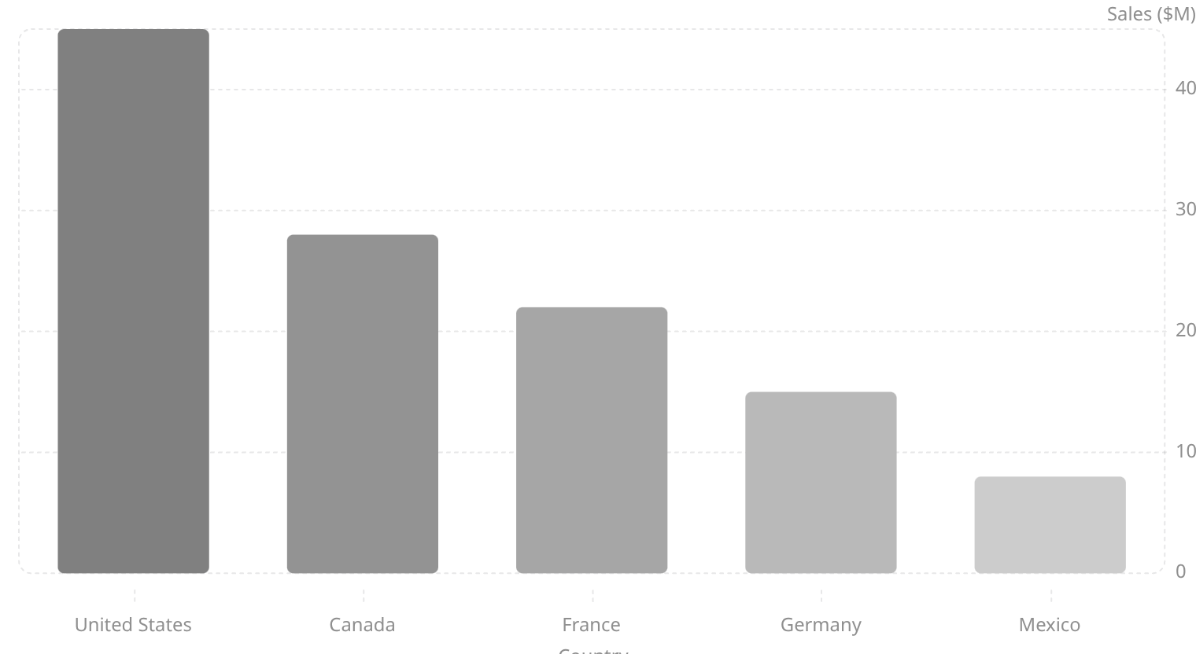
Sales by Country Analysis
Analyzing sales performance by country provides critical geographical insights, highlighting markets with strong contributions and identifying regions with potential for growth or requiring strategic intervention.
Key Insights:
United States: Dominant market, generating the highest sales volume.
Canada & France: Significant contributors, showing strong market presence.
Germany: Moderate sales, indicating room for growth.
Mexico: Lowest sales among the included countries, presenting a clear opportunity for market expansion and targeted promotional strategies.

Slide 9
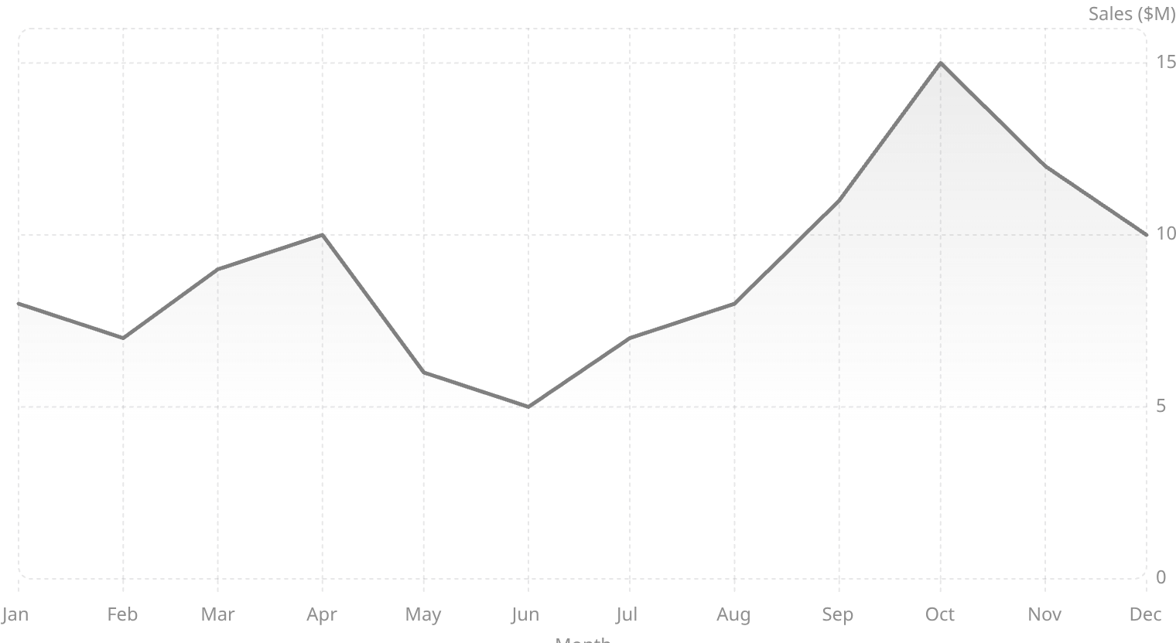
Monthly Sales Trend
Understanding monthly sales fluctuations is crucial for identifying seasonality, predicting future demand, and optimizing operational planning. The trend analysis highlights periods of peak performance and potential dips.
Observations:
Fluctuating Sales: Sales performance varies significantly throughout the year.
Peak Performance: October stands out as the strongest month for sales.
Mid-Year Dip: A noticeable decline in sales during the mid-year period (e.g., May-July).
Year-End Recovery: Strong upward trend towards the end of the year.
Business Meaning:
Seasonal Impact: The trends suggest a strong seasonal component influencing sales.
Stabilizing Low Months: Targeted marketing campaigns and promotions during slower months could help stabilize revenue and reduce volatility.

Slide 10
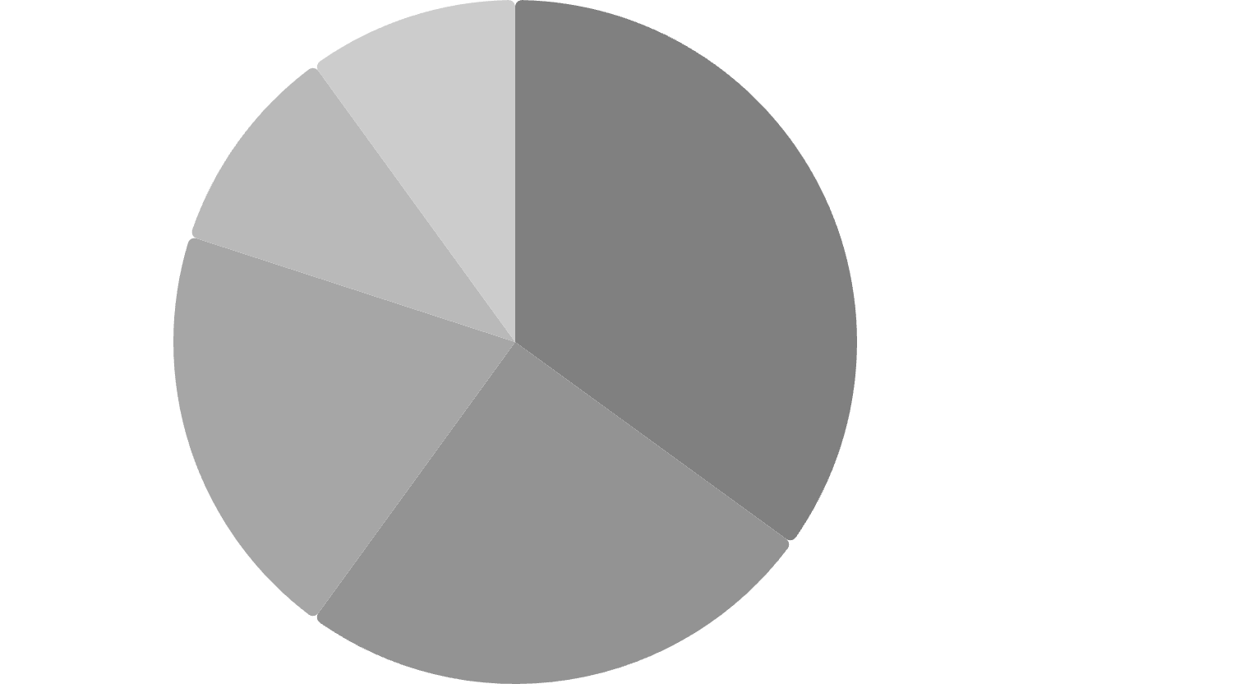

Product Performance Analysis
Understanding product performance from both a cost and profit perspective is vital for optimizing product portfolios, pricing strategies, and manufacturing efficiencies.
Manufacturing Price Distribution:
Profit Contribution:
VTT·35%
·35%
·
Paseo·40%
·40%
·
Amarilla·25%
·25%
·
VTT·25%
·25%
·
Velo·20%
·20%
·
Amarilla·20%
·20%
·
Montana·10%
·10%
·
Montana·10%
·10%
·
Carretera·10%
·10%
·
Carretera·5%
·5%
·
VTT: Contributes the highest manufacturing cost.
Amarilla & Velo: Follow with significant manufacturing costs.
Montana & Carretera: Represent a lower share of manufacturing expenditure.
Paseo: Generates the highest profit contribution.
VTT and Amarilla: Also demonstrate strong profitability.
Balanced Distribution: Overall, profits are distributed across various products.
Insight:
Prioritizing the promotion and efficient production of high-margin, high-demand products like Paseo and VTT will significantly boost overall profitability.

Slide 11
Cost & Sales Relationship
Examining the relationship between Cost of Goods Sold (COGS) and Total Sales is fundamental to evaluating operational efficiency and overall business profitability. This analysis highlights how effectively the company manages its production costs relative to its revenue generation.
Total COGS
Total Sales
$102 Million
$118.73 Million
Key Takeaways:
Good Cost Control: The substantial difference between Total Sales and COGS indicates effective management of production costs.
Positive Gross Margin: A healthy gross margin suggests that the business is earning a good profit on its products before operating expenses are considered.
Optimization Scope: While performance is strong, there remains an opportunity to further optimize manufacturing costs through process improvements or supplier negotiations.
Continued focus on improving operational efficiency and refining the supply chain can lead to even greater profit margins and sustained financial health.

Slide 12





CHAPTER 4
Final Business Recommendations
Based on the comprehensive sales analysis, these strategic recommendations aim to capitalize on strengths, address weaknesses, and drive sustained growth and profitability.
Strengthen High-Performing Markets
Allocate additional resources and marketing efforts to dominant markets like the United States and Canada to maximize their existing potential and capture further market share.
Improve Low-Performing Regions
Implement targeted promotional strategies and localized marketing campaigns in regions such as Mexico and Germany to boost sales and establish a stronger market presence.
Focus on High-Profit Products
Prioritize the promotion and distribution of products like Paseo and VTT, which demonstrate the highest profit contributions, to optimize revenue streams.
Optimize Manufacturing Costs
Conduct a detailed review of production processes for high-cost products to identify opportunities for efficiency gains and cost reduction without compromising quality.
Maintain Data Quality
Continue enforcing structured data cleaning and validation processes for all incoming datasets to ensure ongoing accuracy and reliability of business insights.

